Slide 1
AWS

Slide 2
AWS CICD CodeCommit, CodePipeline, CodeBuild, CodeDeploy, …

Slide 3
CICD – Introduction
• We have learned how to:
Create AWS resources, manually (fundamentals)
Interact with AWS programmatically (AWS CLI)
Deploy code to Ec2
• All these manual steps make it very likely for us to do mistakes!
• We would like our code “in a repository” and have it deployed onto AWS
Automatically
The right way
Making sure it’s tested before being deployed
With possibility to go into different stages (dev, test, staging, prod)
With manual approval where needed

Slide 4
CICD – Introduction
• This section is all about automating the deployment we’ve done so far
while adding increased safety
AWS CodeCommit – storing our code
AWS CodePipeline – automating our pipeline from code to Elastic Beanstalk
AWS CodeBuild – building and testing our code
AWS CodeDeploy – deploying the code to EC2 instances (not Elastic Beanstalk)

Slide 5
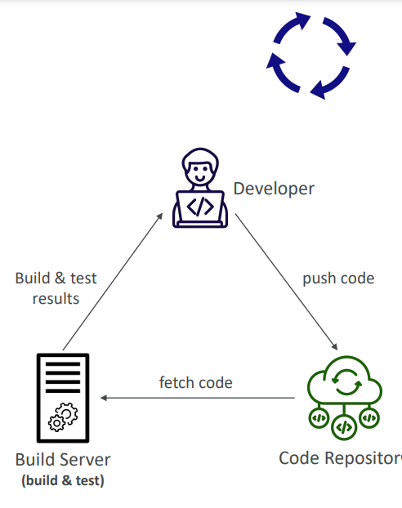
Continuous Integration (CI)
• Developers push the code to a code
repository often (e.g., GitHub, CodeCommit, Bitbucket…)
• A testing / build server checks the code as
soon as it’s pushed (CodeBuild, Jenkins CI, …)
• The developer gets feedback about the tests
and checks that have passed / failed
• Find bugs early, then fix bugs
• Deliver faster as the code is tested
• Deploy often

Slide 6
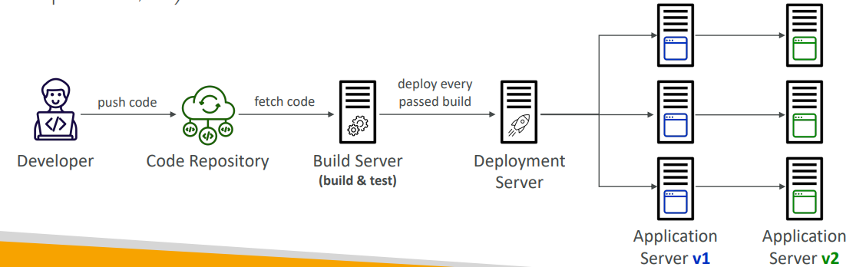
Continuous Delivery (CD)
• Ensures that the software can be released reliably whenever needed
• Ensures deployments happen often and are quick
• Shift away from “one release every 3 months” to ”5 releases a day”
• That usually means automated deployment (e.g., CodeDeploy, Jenkins CD, Spinnaker, …)

Slide 7
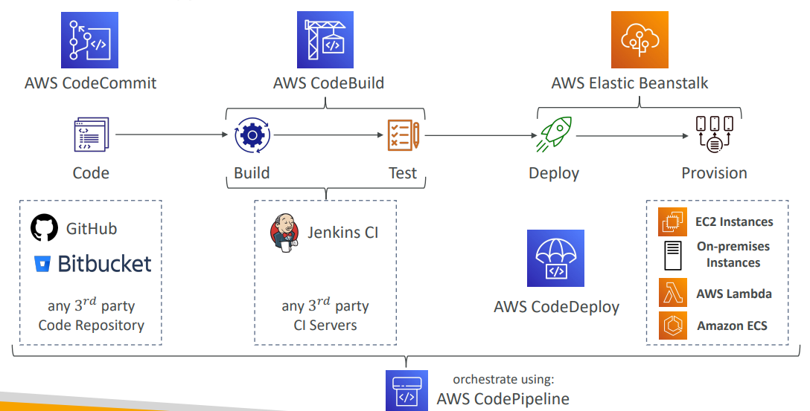
Technology Stack for CICD

Slide 8
AWS CodeCommit • Version control is the ability to understand the various changes that
happened to the code over time (and possibly roll back)
• All these are enabled by using a version control system such as Git
• A Git repository can be synchronized on your computer, but it usually is uploaded on a central online repository
• Benefits are:
Collaborate with other developers
Make sure the code is backed-up somewhere
Make sure it’s fully viewable and auditable

Slide 9
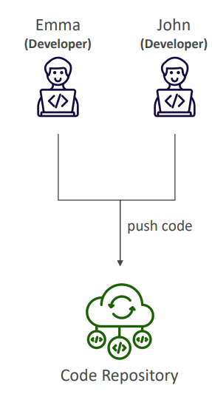
AWS CodeCommit
• The industry includes GitHub, GitLab, Bitbucket, …
• And AWS CodeCommit:
Private Git repositories
No size limit on repositories (scale seamlessly)
Fully managed, highly available
Code only in AWS Cloud account => increased security and compliance
Security (encrypted, access control, …)
Integrated with Jenkins, AWS CodeBuild, and other CI tools

Slide 10
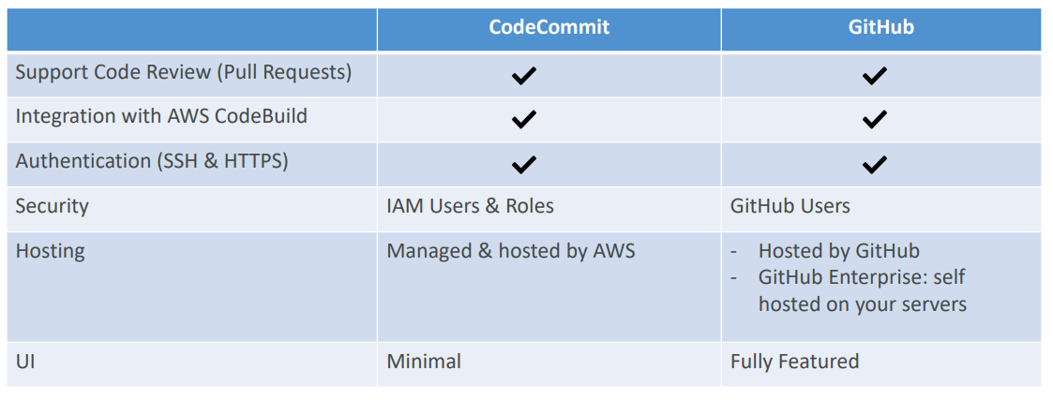
CodeCommit vs. GitHub

Slide 11
AWS CodePipeline
• Visual Workflow to orchestrate your CICD
• Source – CodeCommit, ECR, S3, Bitbucket, GitHub
• Build – CodeBuild, Jenkins, CloudBees, TeamCity
• Test – CodeBuild, AWS Device Farm, 3rd party tools, …
• Deploy – CodeDeploy, Elastic Beanstalk, CloudFormation, ECS, S3, …
• Invoke – Lambda, Step Functions
• Consists of stages:
Each stage can have sequential actions and/or parallel actions
Example: Build →Test →Deploy →Load Testing → …
Manual approval can be defined at any stage

Slide 12
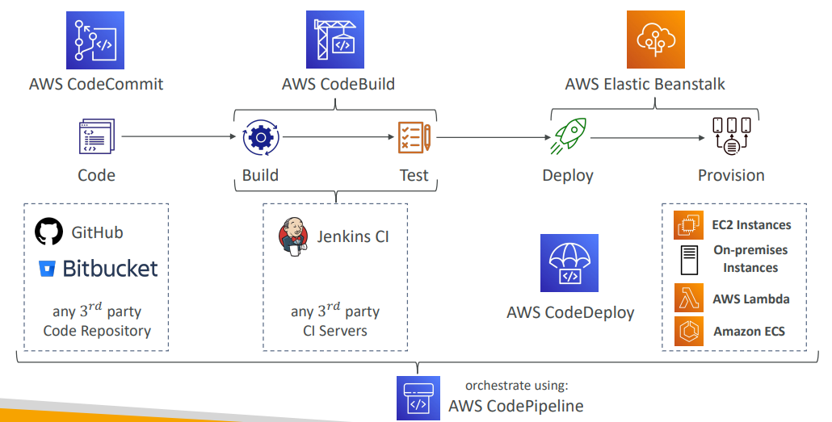
Technology Stack for CICD

Slide 13
AWS CodeBuild
• A fully managed continuous integration (CI) service
• Continuous scaling (no servers to manage or provision – no build queue)
• Compile source code, run tests, produce software packages, …
• Alternative to other build tools (e.g., Jenkins)
• Charged per minute for compute resources (time it takes to complete the builds)
• Leverages Docker under the hood for reproducible builds
• Use prepackaged Docker images or create your own custom Docker image
• Security:
Integration with KMS for encryption of build artifacts
IAM for CodeBuild permissions, and VPC for network security
AWS CloudTrail for API calls logging

Slide 14
AWS CodeBuild
• Source – CodeCommit, S3, Bitbucket, GitHub
• Build instructions: Code file buildspec.yml or insert manually in
Console
• Output logs can be stored in Amazon S3 & CloudWatch Logs
• Use CloudWatch Metrics to monitor build statistics
• Use EventBridge to detect failed builds and trigger notifications
• Use CloudWatch Alarms to notify if you need “thresholds” for failures
• Build Projects can be defined within CodePipeline or CodeBuild

Slide 15
CodeBuild – Supported Environments
• Java
• Ruby
• Python
• Go
• Node.js
• Android
• .NET Core
• PHP
• Docker – extend any environment you like

Slide 16
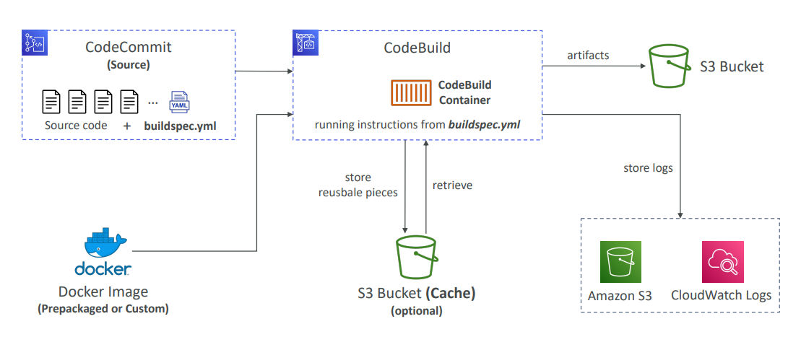
CodeBuild – How it Works

Slide 17
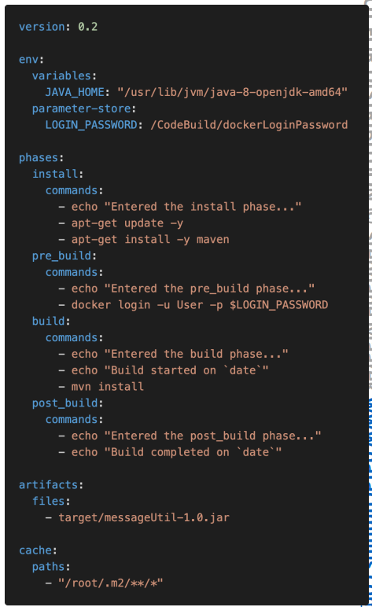
CodeBuild – buildspec.yml
• buildspec.yml file must be at the root of your code
• env – define environment variables
variables – plaintext variables
parameter-store – variables stored in SSM Parameter Store
secrets-manager – variables stored in AWS Secrets Manager
• phases – specify commands to run:
install – install dependencies you may need for your build
pre_build – final commands to execute before build
Build – actual build commands
post_build – finishing touches (e.g., zip output)
artifacts – what to upload to S3 (encrypted with KMS)
cache – files to cache (usually dependencies) to S3 for future build speedup

Slide 18
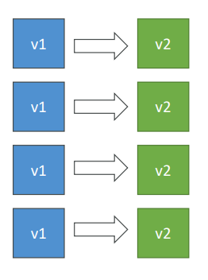
AWS CodeDeploy
• Deployment service that automates
application deployment
• Deploy new applications versions to EC2
Instances, On -premises servers, Lambda
functions, ECS Services
• Automated Rollback capability in case of
failed deployments, or trigger CloudWatch
Alarm
• Gradual deployment control
• A file named appspec.yml defines how the
deployment happens

Slide 19
CodeDeploy – EC2/On-premises Platform
• Can deploy to EC2 Instances & on-premises servers
• Perform in-place deployments or blue/green deployments
• Must run the CodeDeploy Agent on the target instances
• Define deployment speed
AllAtOnce: most downtime
HalfAtATime: reduced capacity by 50%
OneAtATime: slowest, lowest availability impact
Custom: define your %

Slide 20
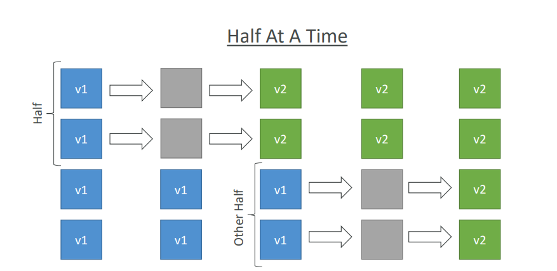
CodeDeploy – In -Place Deployment

Slide 21
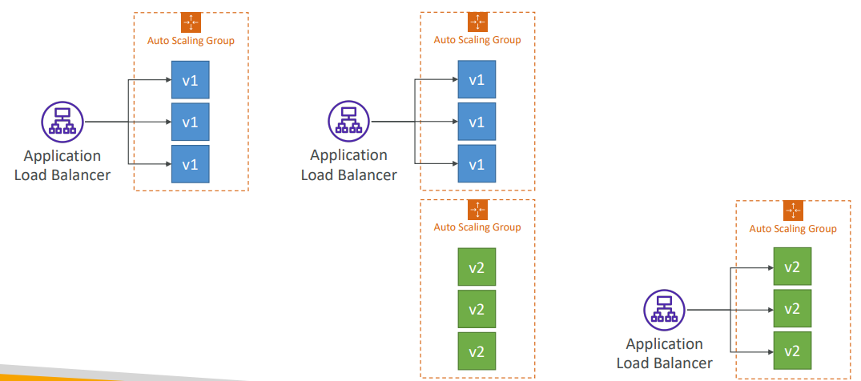
CodeDeploy – Blue-Green Deployment

